Slide 1
Self-Organized Maps (Kohonen)
By Greg
JST - Self-Organized Maps (Kohonen)

Slide 2
History
1982 – 1990: Teuvo Kohonen formulated and then, in 1990, introduced SOM algorithms for Self-Organized Maps, that continue to be explored and extended today
JST - Self-Organized Maps (Kohonen)

Slide 3
Background Theory
Kohonen’s model has a biological and mathematical background.
In neurobiology, many structures in the brain have a linear or planar topology
  They extend in one or two dimensions.
But, sensory experience is multidimensional.
  The eyes as the perception of color, presupposes interaction between three different kinds of light receptors.
  The eyes capture additional information about the structure, position, and texture of objects too.
The question: how do the planar structures in the brain manage to process such multidimensional signals?
JST - Self-Organized Maps (Kohonen)

Slide 4
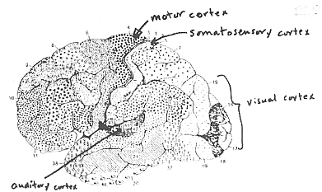
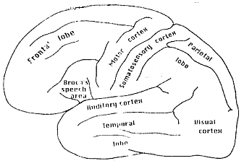
Brain Map
JST - Self-Organized Maps (Kohonen)

Slide 5
Brain Map Glossary
Somatotopic map: projection of body surface onto a brain area, called sematosensory cortex, responsible for sense of touch. (adjacent receptors connected to adjacent neurons in the cortex)
Motor map: Is similar for movement commands instead of touch.
Retinotopic map: Is for vision. The area is called superior colliculus.
Phonotopic map: Is for hearing: the auditory cortex.
JST - Self-Organized Maps (Kohonen)

Slide 6
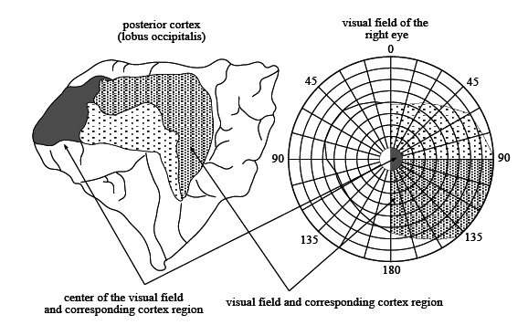
Background Theory
Many neurons work together to decode and process visual impressions.
The visual information is mapped as a two-dimensional projection on the cortex, despite the complexity of the pathway from the retina up to the cortical structures.
A map of the visual cortex by Gordon Holmes at the beginning of the century
JST - Self-Organized Maps (Kohonen)

Slide 7
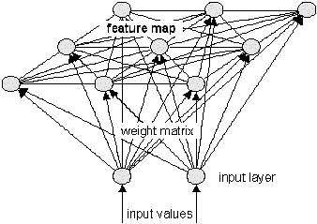
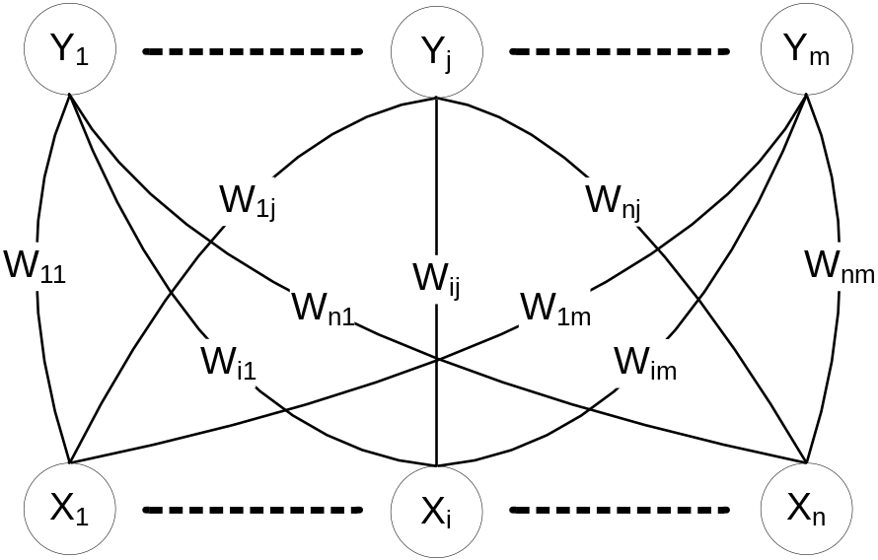
SOM Architecture
One Dimensional SOM Two Dimensional SOM
JST - Self-Organized Maps (Kohonen)

Slide 8
Unsupervised learning
The network must discover for itself patterns, features, regularities, correlations or categories in the input data and code them for the output.
The units and connections must self-organize themselves based on the stimulus they receive.
Unsupervised learning attempt to discover special patterns from available data without external help.
  There is no information about the desired class (or output ) d of an example x. So only x is given.
Note: Unsupervised learning is useful only when there is redundancy in the input data.
  Redundancy provides knowledge.
JST - Self-Organized Maps (Kohonen)

Slide 9
Goal
For an input, the output of the neural network will be the neuron whose weight vector is most similar (using Euclidean distance) to that input.
In this way each (weight vector of a) neuron is the center of a cluster containing all the input examples which are mapped to that neuron.
JST - Self-Organized Maps (Kohonen)

Slide 10
What can be expected?
Familiarity: Single continuous output telling how similar the input to the previously seen patterns.
Principal Component Analysis: Extend the previous case to multi-dimensions. Construct a set of data along which similarity can be measured.
Clustering: A set of binary outputs, one on at a time.
Prototyping: Form the categories as previous item, but give the output as prototype or exemplar of the class.
Encoding: Encode the input with fewer bits keeping as much relevant information as possible.
Feature mapping: Output units have a fixed topographical arrangement such that similar inputs map to nearby output units.
JST - Self-Organized Maps (Kohonen)

Slide 11
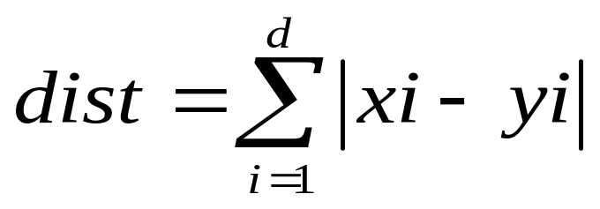

Distance
Distances are normally used to measure the similarity or dissimilarity between two data objects
Standardization is necessary, if scales differ.
Manhattan Distances:
Euclidean Distances:
JST - Self-Organized Maps (Kohonen)

Slide 12

Distance
Minkowski Distances:
  Minkowski Distance is a generalization of Euclidean Distance
JST - Self-Organized Maps (Kohonen)

Slide 13
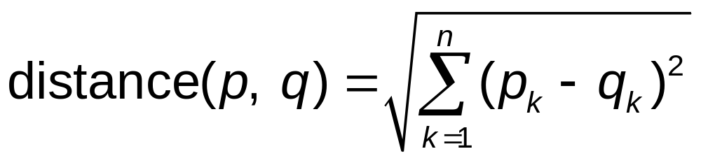
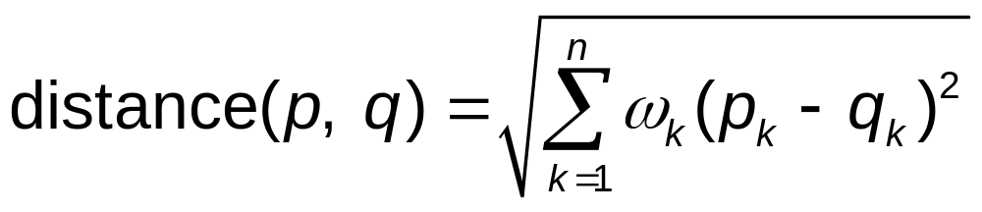
Weighted Euclidean Distance
Where:
  n is the number of dimensions (attributes),
  p_{k} and q_{k} are the k-th attributes (components) or data objects p and q, and
  ω_{k} is the weight of each dimensions (attributes).
JST - Self-Organized Maps (Kohonen)

Slide 14
SOM Architecture
One Dimensional SOM Two Dimensional SOM
JST - Self-Organized Maps (Kohonen)

Slide 15
SOM Learning Algorithm (Basic)
Step 0: Initialize weights W_{ij} (Random Value, from the same range of value of the input vector)
Set topological neighborhood parameters R
Set learning rate parameters α
Step 1: While stopping condition is false, do Steps 2 – 8
Step 2: For each input vector x, do Step 3 – 5
Step 3: For each j, compute:
D(j) = Σ_{i} (w_{ij} – x_{i})² (Squared Euclidean)
Step 4: Find index J such that D(j) is a minimum
Step 5: For all units j within a specified neighborhood of J, and for all i:
w_{ij}(new) = w_{ij}(old) + α[x_{i} – w_{ij}(old)]
Step 6: Update learning rate α
Step 7: Reduce radius of topological neighborhood R at specified times (not in every iteration).
Step 8: Test stopping condition
JST - Self-Organized Maps (Kohonen)

Slide 16
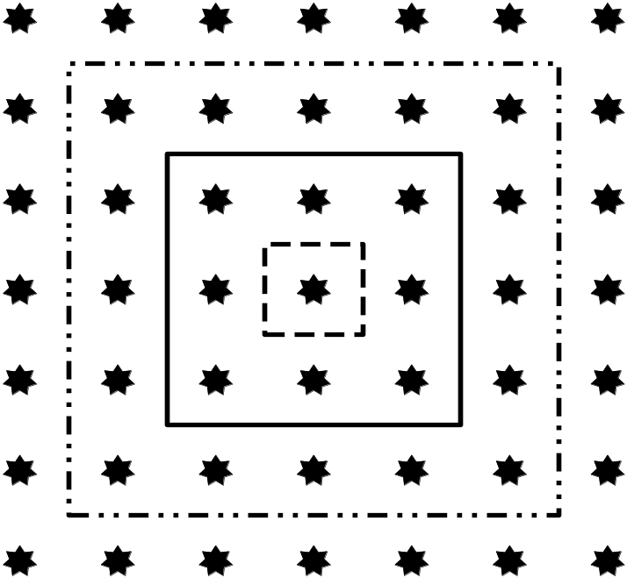
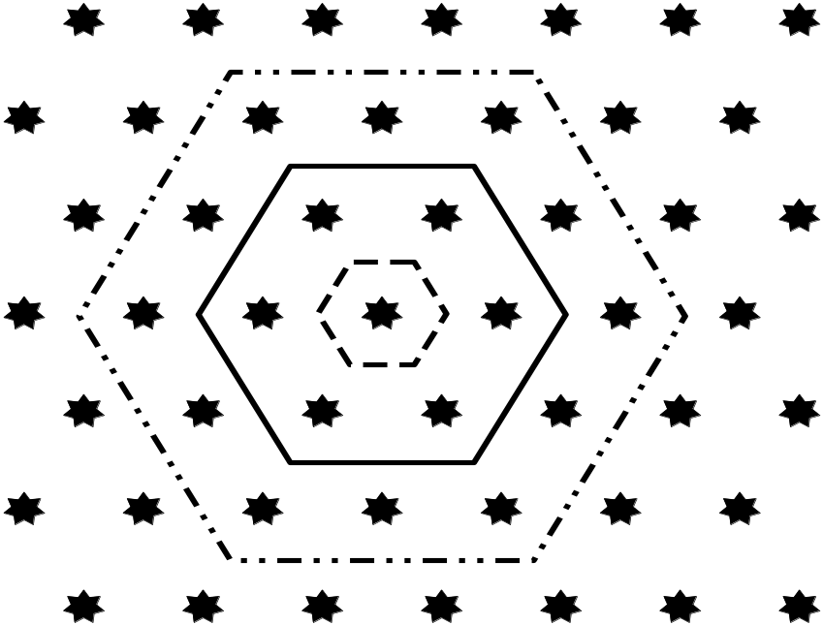
SOM Learning Algorithm (Basic)
Learning rate α is slowly decreasing function of time (or training epoch)
The Radius of Neighborhood J also decreases as the clustering process progresses.
Rectangular Grid Hexagonal Grid
Neighborhood Neighborhood
JST - Self-Organized Maps (Kohonen)

Slide 17
Example
SOM to cluster 4 data vectors
    (1, 1, 0, 0)
    (0, 0, 0, 1)
    (1, 0, 0, 0)
    (0, 0, 1, 1)
Max cluster m = 2
Learning rate α(0) = 0.6
α(t + 1) = 0.5 * α(t)
Weight update radius R = 0
JST - Self-Organized Maps (Kohonen)

Slide 18
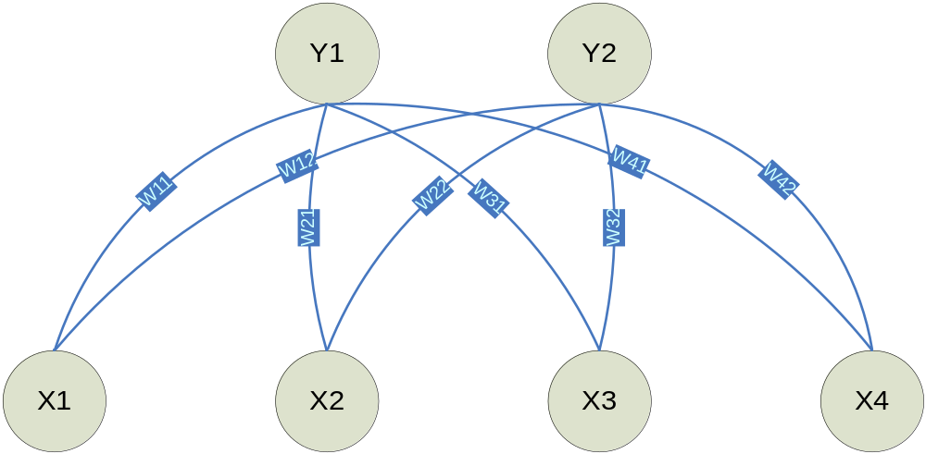
Example: SOM Architecture
JST - Self-Organized Maps (Kohonen)

Slide 19
Example (Training)
Step 0: Initial weight matrix
w11 w12 0.2 0.8
w21 w22 = 0.6 0.4
w31 w32 0.5 0.7
w41 w42 0.9 0.3
First Epoch of Training
Step 1: Begin Training
Step 2: For data vector 1 -> (1, 1, 0, 0)
Step 3: D(1) = (0.2-1)² + (0.6-1)² + (0.5-0)² + (0.9-0)²
= 1.86
D(2) = (0.8-1)² + (0.4-1)² + (0.7-0)² + (0.3-0)²
= 0.98
Step 4: Closest / Winning Neuron J = 2
JST - Self-Organized Maps (Kohonen)

Slide 20
Example (Training)
Step 5: Update weight of winning neuron
w_{i2}(new) = w_{ij}(old) + α(x_{i} – w_{ij}(old))
= w_{i2}(old) + 0.6(x_{i} – w_{i2}(old))
= 0.4w_{i2}(old) + 0.6x_{i}
W₁₂(new) = 0.4*0.8 + 0.6*1 = 0.92, etc…
New weight matrix
0.2 0.92
0.6 0.76
0.5 0.28
0.9 0.12
JST - Self-Organized Maps (Kohonen)

Slide 21
Example (Training)
Step 2: For data vector 2 -> (0, 0, 0, 1)
Step 3: D(1) = (0.2-0)² + (0.6-0)² + (0.5-0)² + (0.9-1)²
= 0.66
D(2) = (0.92-0)² + (0.76-0)² + (0.28-0)² + (0.12-1)²
= 2.28
Step 4: Closest / Winning Neuron J = 1
Step 5: Update weight of winning neuron
0.08 0.92
0.24 0.76
0.20 0.28
0.96 0.12
JST - Self-Organized Maps (Kohonen)

Slide 22
Example (Training)
Step 2: For data vector 3 -> (1, 0, 0, 0)
Step 3: D(1) = (0.08-1)² + (0.24-0)² + (0.20-0)² + (0.96-0)²
= 1.866
D(2) = (0.92-0)² + (0.76-0)² + (0.28-0)² + (0.12-1)²
= 0.677
Step 4: Closest / Winning Neuron J = 2
Step 5: Update weight of winning neuron
0.08 0.968
0.24 0.304
0.20 0.112
0.96 0.048
JST - Self-Organized Maps (Kohonen)

Slide 23
Example (Training)
Step 2: For data vector 4 -> (0, 0, 1, 1)
Step 3:
D(1) = (0.08-0)² + (0.24-0)² + (0.20-1)² + (0.96-1)²
= 0.706
D(2) = (0.968-0)² + (0.36-0)² + (0.112-1)² + (0.048-1)²
= 2.724
Step 4: Closest / Winning Neuron J = 1
Step 5: Update weight of winning neuron
0.032 0.968
0.096 0.304
0.680 0.112
0.984 0.048
JST - Self-Organized Maps (Kohonen)

Slide 24
Example (Training)
Step 6: Reduce Learning rate
α = 0.5 * 0.6 = 0.3
New weight update equation:
w_{ij}(new) = w_{ij}(old) + 0.3(x_{i} – w_{ij}(old))
= 0.7w_{ij}(old) + 0.3x_{i}
The Weight Matrix after Second Epoch of Training:
0.016 0.980
0.047 0.360
0.630 0.055
0.999 0.024
Repeat the training until the weight matrix convergence (not change).
JST - Self-Organized Maps (Kohonen)

Slide 25
Example (Testing)
Testing:
Assume convergence weight matrix
0.0 1.0
0.0 0.5
0.5 0.0
1.0 0.0
Step 2: For data vector 1 -> (1, 1, 0, 0)
Step 3: D(1) = (0.0-1)² + (0.0-1)² + (0.5-0)² + (1.0-0)²
= 1 + 1 + 0.25 + 1 = 3.25
D(2) = (1.0-1)² + (0.5-1)² + (0.0-0)² + (0.0-0)²
= 0 + 0.25 + 0 + 0 = 0.25
Step 4: Closest / Winning Neuron J = 2
Vector 1 = Cluster 2
JST - Self-Organized Maps (Kohonen)

Slide 26
Example (Testing)
Step 2: For data vector 2 -> (0, 0, 0, 1)
Step 3: D(1) = (0.0-0)² + (0.0-0)² + (0.5-0)² + (1.0-1)²
= 0 + 0 + 0.25 + 0 = 0.25
D(2) = (1.0-0)² + (0.5-0)² + (0.0-0)² + (0.0-1)²
= 1 + 0.25 + 0 + 1 = 2.25
Step 4: Closest / Winning Neuron J = 1
Vector 2 = Cluster 1
Step 2: For data vector 3 -> (1, 0, 0, 0)
Step 3: D(1) = (0.0-1)² + (0.0-0)² + (0.5-0)² + (1.0-0)²
= 1 + 0 + 0.25 + 1 = 2.25
D(2) = (1.0-1)² + (0.5-0)² + (0.0-0)² + (0.0-0)²
= 0 + 0.25 + 0 + 0 = 0.25
Step 4: Closest / Winning Neuron J = 2
Vector 3 = Cluster 2
JST - Self-Organized Maps (Kohonen)

Slide 27
Example (Testing)
Step 2: For data vector 4 -> (0, 0, 1, 1)
Step 3: D(1) = (0.0-0)² + (0.0-0)² + (0.5-1)² + (1.0-1)²
= 0 + 0 + 0.25 + 0 = 0.25
D(2) = (1.0-0)² + (0.5-0)² + (0.0-1)² + (0.0-1)²
= 1 + 0.25 + 1 + 1 = 2.25
Step 4: Closest / Winning Neuron J = 1
Vector 2 = Cluster 1
Data Classification (Assume: New Vector -> (1, 1, 1, 0))
Step 2: For New data vector -> (1, 1, 1, 0)
Step 3: D(1) = (0.0-1)² + (0.0-1)² + (0.5-1)² + (1.0-0)²
= 1 + 1 + 0.25 + 1 = 3.25
D(2) = (1.0-1)² + (0.5-1)² + (0.0-1)² + (0.0-0)²
= 0 + 0.25 + 1 + 0 = 1.25
Step 4: Closest / Winning Neuron J = 2
New Vector = Cluster 2
JST - Self-Organized Maps (Kohonen)

Slide 28
Example (Testing)
Data Classification (Assume: New Vector -> (1, 0, 1, 1))
Step 2: For New data vector -> (1, 0, 1, 1)
Step 3: D(1) = (0.0-1)² + (0.0-0)² + (0.5-1)² + (1.0-1)²
= 1 + 0 + 0.25 + 0 = 1.25
D(2) = (1.0-1)² + (0.5-0)² + (0.0-1)² + (0.0-1)²
= 0 + 0.25 + 1 + 1 = 2.25
Step 4: Closest / Winning Neuron J = 1
New Vector = Cluster 1
Data Classification (Assume: New Vector -> (1, 1, 1, 1))
Step 2: For New data vector -> (1, 1, 1, 1)
Step 3: D(1) = (0.0-1)² + (0.0-1)² + (0.5-1)² + (1.0-1)²
= 1 + 1 + 0.25 + 0 = 2.25
D(2) = (1.0-1)² + (0.5-1)² + (0.0-1)² + (0.0-1)²
= 0 + 0.25 + 1 + 1 = 2.25
Step 4: Closest / Winning Neuron J = Unknown
New Vector = ???
JST - Self-Organized Maps (Kohonen)

Slide 29
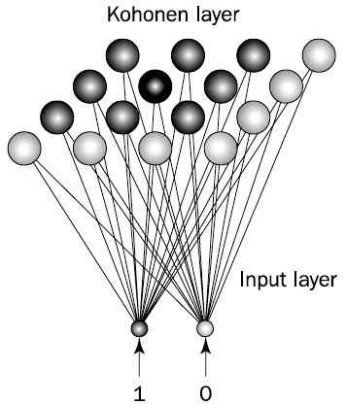
2 Dimension Map SOM
Component:
  Input
  Weight Matrix
  Array
  Distance formula
  Weight evaluation
Process :
  Training
  Testing
JST - Self-Organized Maps (Kohonen)

Slide 30
Training
Inisialisasi neuron input :
x₁, x₂, x₃, ..., x_{i}
Inisialisasi neuron output 2 dimensi:
y₁₁, y₁₂, y₁₃, ..., y_{jl}.
Mengisi bobot antara neuron input dan output yang dinotasikan dengan μ_{ijl}, dengan bilangan random 0 sampai 1.
JST - Self-Organized Maps (Kohonen)

Slide 31
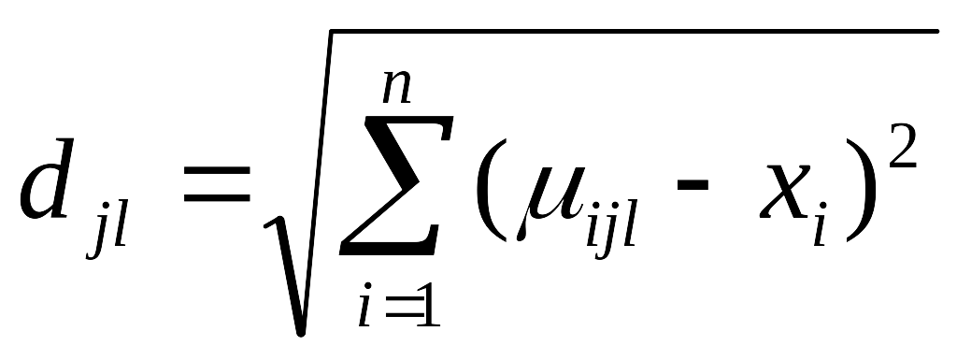
Training
Mengulangi langkah-langkah 5 s/d 8 hingga tidak ada perubahan pada bobot map atau iterasi telah mencapai iterasi maksimal.
  Pemilihan salah satu input dari vektor input yang ada.
  Penghitungan jarak antar vektor input terhadap bobot (d_{jl}) dengan masing – masing neuron output dengan rumus euclidean distance yaitu :
  Dari seluruh bobot ( d_{jl} ) dicari yang paling kecil. Index dari bobot ( d_{jl} ) yang paling mirip disebut winning neuron.
  Untuk setiap bobot diperbaharui bobot koneksinya dengan menggunakan rumus yang dapat dilihat pada persamaan :
Simpan bobot yang telah konvergen.
JST - Self-Organized Maps (Kohonen)

Slide 32
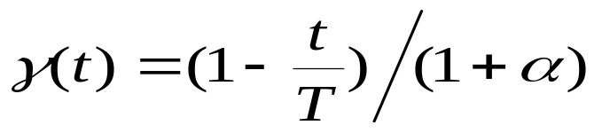
Learning Rate (γ(t))
Menunjukkan bagaimana adaptasi pembelajaran terhadap data. Fungsi skalar adaptasi bernilai 0 ≤ γ(t) ≤1
Semakin besar nilai γ(t), semakin cepat bobot koneksi beradaptasi / semakin besar pengaruh vektor input terhadap perubahan bobot koneksi yang terjadi.
Semakin lama semakin kecil, berkurang seiring berjalannya waktu / iterasi.
Semakin lama -> γ(t) akan mendekati 0, perubahan bobot semakin lama akan semakin kecil dan vektor-vektor input dapat dipetakan dengan baik.
Fungsi γ(t) yang digunakan adalah penurunan konstan yaitu:
    Dimana: t ⇒ iterasi sekarang; T ⇒ setting max iterasi;
    α ⇒ nilai penurunan learning rate
JST - Self-Organized Maps (Kohonen)

Slide 33
Fungsi Tetangga (Neighborhood)
Fungsi h_{ijbc}(t) ➔ fungsi tetangga, yang bernilai
0 ≤ h_{ijbc}(t) ≤ 1
Memberi pengaruh perubahan bobot secara proporsional dari neuron best matching ke neuron-neuron tetangganya
Semakin lama semakin kecil, berkurang seiring berjalannya waktu / iterasi dan mendekati 0
Semakin lama pengaruh dari perubahan bobot semakin menyempit, akhirnya hanya neuron best matching yang dipengaruhi
Dipengaruhi oleh Learning Rate
JST - Self-Organized Maps (Kohonen)

Slide 34
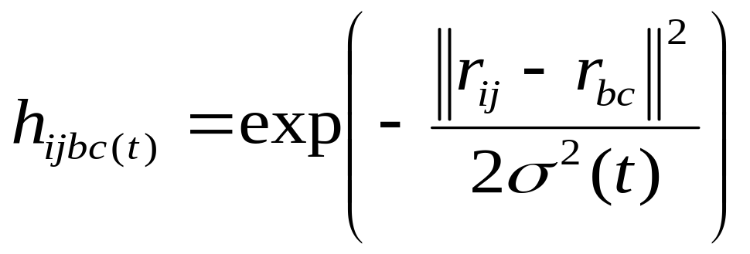
Fungsi Tetangga (Neighborhood)
Fungsi Gaussian yang digunakan :
|r_{ij} – r_{bc}| adalah jarak antara neuron yang akan diubah bobotnya terhadap winning neuron.
σ(t) adalah lebar kernel (lebar dimensi dari neuron output) yang dipengaruhi oleh (dikalikan dengan) learning rate γ(t).
σ(t) akan berkurang secara konstan mendekati 0 seiring dengan berjalannya waktu / proses pembelajaran.
Perubahan ini bertujuan membawa neuron-neuron ke posisi yang stabil / konvergen. Artinya : semakin lama perubahan semakin kecil
JST - Self-Organized Maps (Kohonen)

Slide 35
Testing (Clustering)
Insialisasi bobot μ_{ijl} dengan bobot hasil training (load last convergent weight)
Bentuk cluster – cluster dari vektor data training (yang digunakan sebelumnya) dengan cara sama dengan proses training, tetapi tanpa meng-update bobot.
Definisikan spesifikasi output dari tiap cluster berdasarkan spesifikasi output dari tiap data training dalam cluster tersebut.
Masukkan vektor data baru yang akan di test dan lakukan proses clustering untuk semua vektor data baru.
Update spesifikasi ouput tiap data baru dengan spesifikasi output dari tiap cluster dimana dia berada.
JST - Self-Organized Maps (Kohonen)

Slide 36
Aplikasi Cluster Analysis Menggunakan Self Organizing Maps (SOM) Untuk Analisa Talenta Pemain Basket
Steven Harryanto
26402058
JST - Self-Organized Maps (Kohonen)

Slide 37
Latar Belakang & Tujuan
Perkembangan olahraga bola basket yang meningkat pesat
Tuntutan untuk membentuk tim yang solid
Keterbatasan Pelatih (Coach) dan Pencari Bakat (Scout) sebagai manusia biasa
Pelatih (Coach) dan Pencari Bakat (Scout) dituntut untuk teliti dalam memutuskan dan melihat bakat seorang pemain
Tujuan: Membantu analisa dan proses pengambilan keputusan, sehingga mempermudah pencarian pemain berbakat sesuai kebutuhan tim.
JST - Self-Organized Maps (Kohonen)

Slide 38
Perumusan Masalah
Menentukan statistik / data yang akan digunakan dalam proses clustering sebagai dasar untuk analisa dan pengambilan keputusan terhadap seorang pemain basket.
Bagaimana program yang dibuat dapat memberikan gambaran / kemungkinan - kemungkinan ciri-ciri masa depan seorang pemain basket
Untuk pengujian:
  Proses training -> data-data pemain NBA
  Proses testing -> data-data pemain basket U.K. Petra, pemain lokal / pemain baru Indonesia
Menggunakan metode Self Organizing Maps (SOM)
JST - Self-Organized Maps (Kohonen)

Slide 39
Perumusan Masalah
Data statistik pemain basket untuk keperluan training algoritma SOM diambil dari :
  www.nba.com
  www.basketindonesia.com
  www.basketballreference.com
Result akan menampilkan :
  Pemain yang di-testing ada dalam cluster mana
  Lengkap dengan semua data statistik pemain-pemain yang berada dalam cluster tersebut, beserta dengan nilai rata-rata statistik pemain-pemain dalam suatu cluster tersebut.
JST - Self-Organized Maps (Kohonen)

Slide 40
Coach / Scout Harus Mengerti Karakter Pemain Basket
Posisi pemain basket di lapangan :
  Guard
  Forward
  Center
Posisi dalam bola basket bisa bertukar, lain halnya dengan sepak bola
Sehingga seringkali membingungkan pelatih / pemandu bakat untuk mengetahui bakat / karakteristik pemain dan menempatkannya pada posisi tertentu
JST - Self-Organized Maps (Kohonen)

Slide 41
Coach / Scout Harus Mengerti Karakter Pemain Basket
Posisi dipengaruhi oleh :
Nantinya akan mempengaruhi bakat / talenta dan karakteristik pemain
Height | 3 Point Percentage | Steals
Weight | Free Throw Percentage | Blocks
Games | Defensive Rebounds | Turnovers
Games Started | Offensive Rebounds | Fouls
Minutes | Total Rebounds | Points
Field Goal Percentage | Assists
JST - Self-Organized Maps (Kohonen)

Slide 42

Data Cleaning & Data Transformation
Data Cleaning:
  Menghilangkan noise / gangguan pada data
  No error input / valid input
Data Transformation:
  Generalization: Ubah data yang memiliki banyak nilai menjadi range – range nilai data.
  Normalization: menskala tiap atribut data yang memiliki besaran beraneka ragam menjadi range tertentu agar semua atribut memiliki kemungkinan yang sama dalam mempengaruhi hasil proses clustering.
    Menggunakan Min-Max Normalization
JST - Self-Organized Maps (Kohonen)

Slide 43
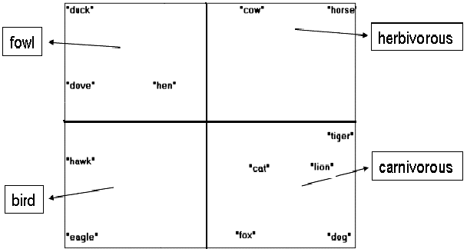
Clustering
Menggolongkan data menjadi kelompok-kelompok untuk dianalisa lebih lanjut.
Neural Network Self Organizing Maps (SOM)
JST - Self-Organized Maps (Kohonen)

Slide 44
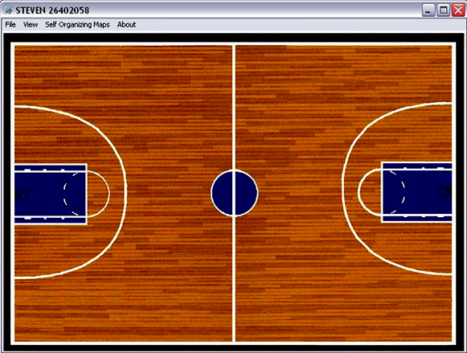
Program
JST - Self-Organized Maps (Kohonen)

Slide 45
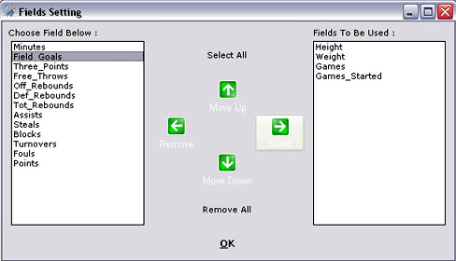
Program (lanj.)
JST - Self-Organized Maps (Kohonen)

Slide 46
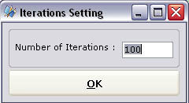
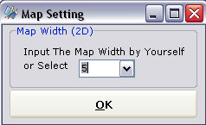
Program (lanj.)
JST - Self-Organized Maps (Kohonen)

Slide 47
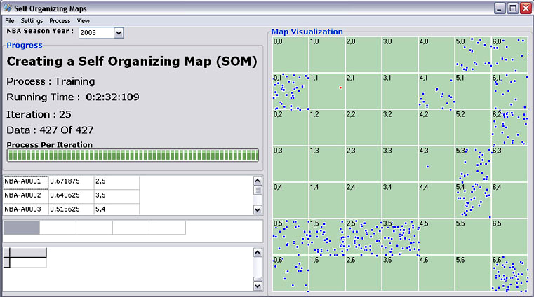
Program (lanj.)
JST - Self-Organized Maps (Kohonen)

Slide 48
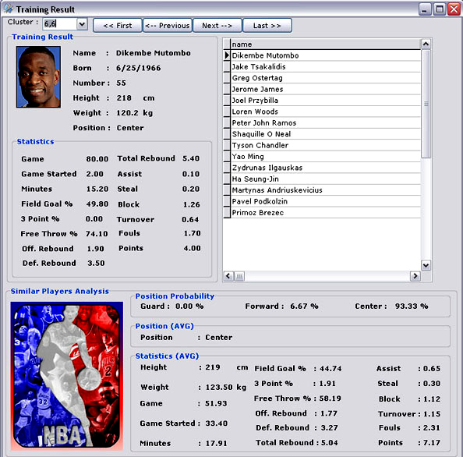
Program (lanj.)
JST - Self-Organized Maps (Kohonen)

Slide 49
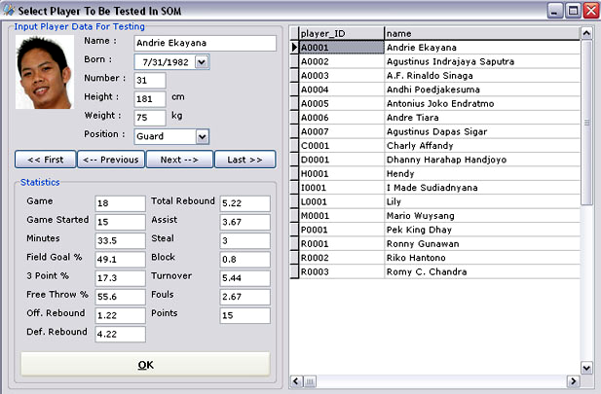
Program (lanj.)
JST - Self-Organized Maps (Kohonen)

Slide 50
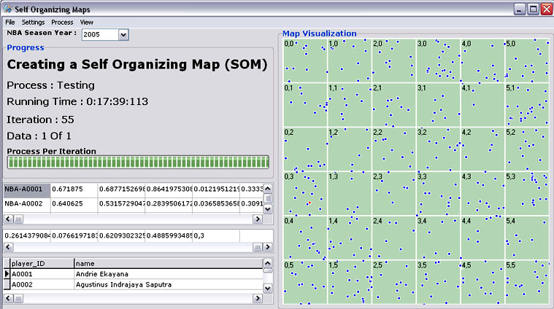
Program (lanj.)
JST - Self-Organized Maps (Kohonen)

Slide 51
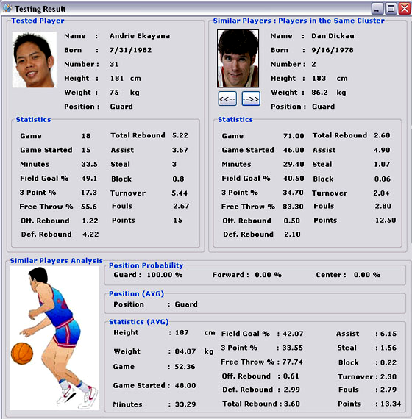
Program (lanj.)
JST - Self-Organized Maps (Kohonen)

Slide 52
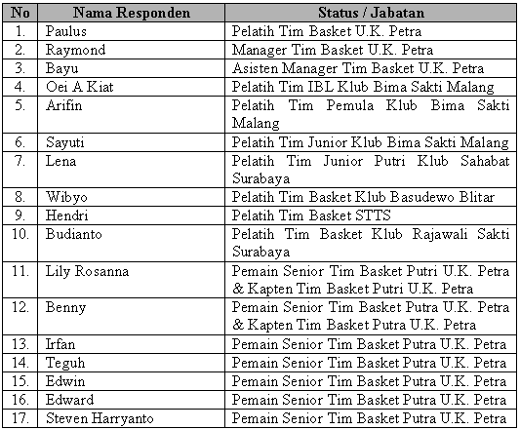
Pengujian oleh Calon Pengguna Aplikasi
Nama-nama Responden Beserta Status / Jabatannya
JST - Self-Organized Maps (Kohonen)

Slide 53
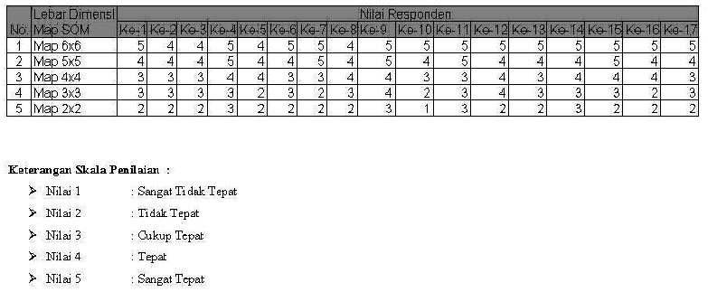
Hasil Kuisioner (penentuan lebar kernel)
JST - Self-Organized Maps (Kohonen)

Slide 54

Hasil Kuisioner (penentuan lebar kernel)
Map 6x6 :
(5+4+4+5+5+4+5+5+4+5+5+5+5+5+5+5+5) / 85 * 100% = 95 %
Map 5x5 :
(4+4+4+4+5+4+4+5+4+5+4+5+4+4+4+5+4) / 85 * 100% = 81 %
Map 4x4 :
(3+3+3+3+4+4+3+3+4+4+3+3+4+3+4+4+4) / 85 * 100% = 69 %
Map 3x3 :
(3+3+3+3+3+2+3+2+3+4+2+3+4+3+3+3+2) / 85 * 100 % = 54 %
Map 2x2 :
(2+2+2+2+3+2+2+2+2+3+1+3+2+2+3+2+2) / 85 * 100 % = 44 %
JST - Self-Organized Maps (Kohonen)

